Slide 1
Kafka: The Definitive Guide
Chapter 3: Kafka Producers: Writing Messages to Kafka

Slide 2
TOC
Producer Overview
Methods of Sending Message
Multi-thread Concern

Slide 3
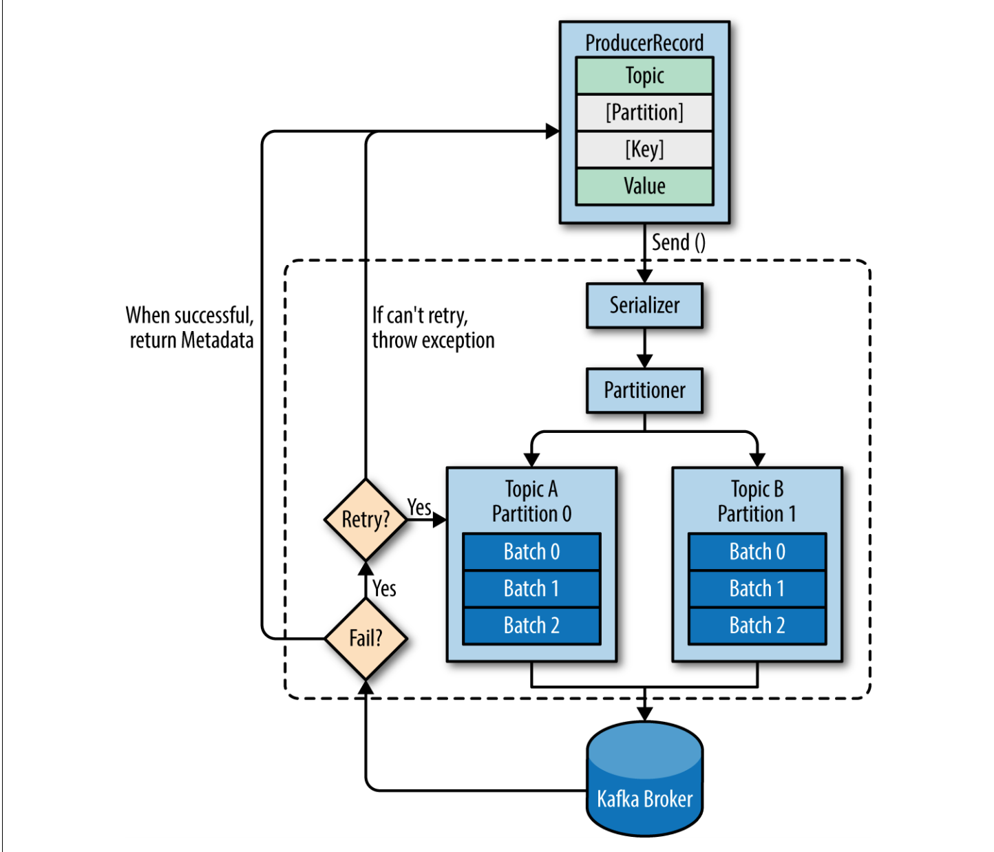
Producer Overview
Create a ProducerRecord, which must include the topic we want to send the record to and a value. (optionally, we can also specify a key and/or a partition)
Once the ProducerRecord sent, the producer will serialize the key and value objects to ByteArrays so they can be sent over the network.
Next, the partitioner will decide to which partition this message should be sent. If the partition is not specified in the ProducerRecord, the decision is usually based on the key of ProducerRecord.
Add this record to a batch of records that also be sent to the same topic and partition.
A separate thread is responsible for sending those batches of records to the appropriate Kafka brokers.
When broker receives the messages, it sends back a response, a RecordMetadata for a successful commit or an error if it fails. (In case of fail, it may retry sending the message a few more times before giving up and return error)

Slide 4
Methods of Sending Message
Fire-and-forget
  Send a message and don’t really care if it arrives successfully or not.
Synchronous send
  Send a message and returns a Future object and we wait on that to see if it sent successfully.
Asynchronous send
  Send a message with a callback function, which gets triggered when it receives a response from the Kafka broker.

Slide 5
Multi-thread Concern
A producer object can be used by multiple threads to send messages.
You will probably want to start with one producer and one thread
If you need better throughput, you can add more threads that use the same producer.
Once this ceases to increase throughput, you can add more producer to the application to achieve even higher throughput.

Slide 6
End
Thanks

